Slide 1
David Kooi 2017 Internship Summary

Slide 2

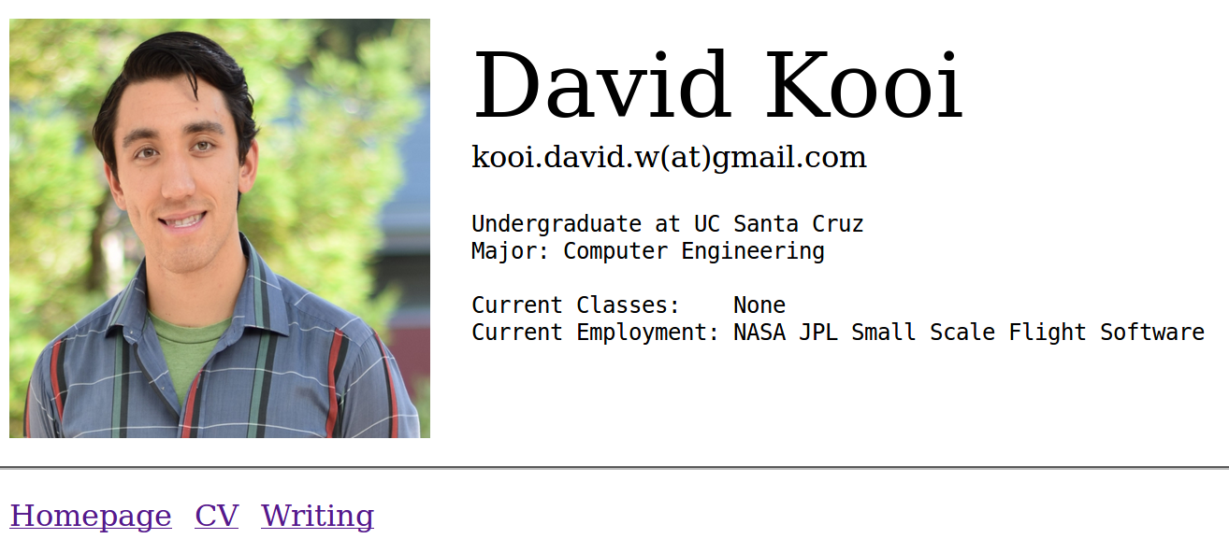
About Me
Mentor: Len Reder, Garth Watney
Project: ESD Infrastructure Task: Portable Ground System for Small Spacecraft
School: UC Santa Cruz
Degree: BS/MS Computer Engineering
Grad date: Bachelors: 2018, Masters: 2019
Senior at UC Santa Cruz
Involved in our IEEE chapter
On the C&DH team for our universities’ first cube sat, Slug Sat
Enjoy personal projects such as
Building a remote gsm data station
Building a personal site (In development)
SlugSat Team Image
Personal image
Personal image
Notes:
IEEE – Member and proposed project ideas
Slug Sat – 1U Amateur radio transponder. Working on getting data to and from the satellite
Gsm Data Station – Starting simple with temperature and solar intensity
Personal Site – Host my resume, personal writing, and provide a server for incoming data station telemetry. This past weekend successfully posted data to the server!

Slide 3
My Work at JPL
Overview of summer work
Designed new FPrime GSE Server
Uses ZeroMQ middleware
Cross platform, high-performance, asynchronous, distributed messaging library.
Supports reconnect capability
Supports protocol translation
Supports multi-target communication
Updated GSE GUI for use with ZMQ and maintained backwards compatibility with legacy TCP Server
Tested for server integrity and throughput
Implemented C++ Zmq Radio component within FPrime
Emulates a radio connection between a flight target and the GSE Server
Prevents embedded flight target from hanging up on disconnections from GSE.
Notes:
ZMQ – Fun fact, it is used by CERN’s Remote Device Access library where they need to connect thousands of data points from around the collider
Reconnect capability – Allow clients to arbitrarily connect and disconnect. Pervious server had issues with this.
Protocol Translation – FPrime GSE works with native Fprime packets. Inline protocol translation allows the Fprime ground system to be data agnostic.
Multi target - ZMQ allows many to many communication. The server provides single point communication support for sets of satellites or sets of test equipment.
Updated GSE GUI – It is important to provide backwards compatibility. The Fprime GSE GUI works with the legacy TCP server and the new ZMQServer.
Server Tests: Created a test framework for these two sets of tests.
Server Integrity – Two things: tested that the server could withstand abrupt disconnections. Tested data integrity. Need to ensure that no packets are dropped during operation.
Throughput - Tested throughput with various configurations of publishers and subscribers. Server can achieve 2mb/s.

Slide 4
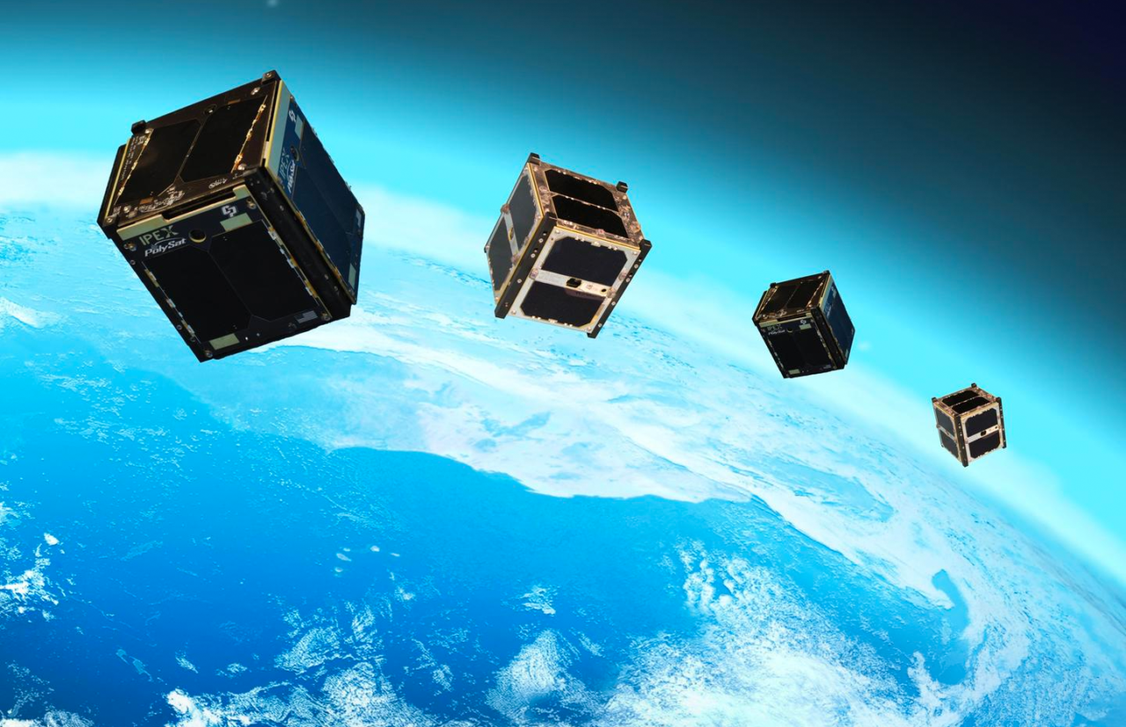
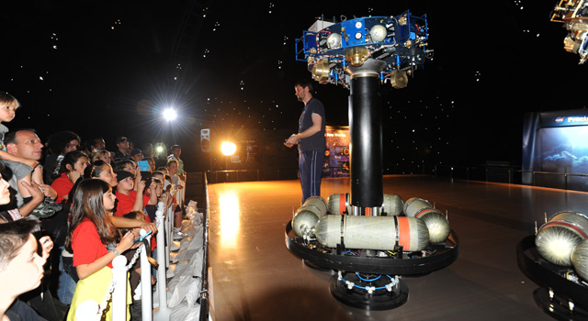
Use Cases
Near-term:
JPL’s Formation Flying Testbed
Enable multi-target communication
DoD Testbed configuration
Far-term:
Constellations of satellites
http://www.satellitetoday.com/newspace/2017/05/24/roccor-exec-supporting-900
-satellite-leo-constellation/
https://www.jpl.nasa.gov/news/news.php?feature=2985
Notes:
Formation Flying Testbed: Multiple robots streaming telemetry and receiving commands. Allows central control of the communication’s datapath
DoD testbed: Flight hardware running in parallel with a hardware simulation. Before the datapaths were separate. Now data paths go through one point.
Constellations: Have a university with 3 satellites. Instead of managing three servers, three telemetry databases, there is one server, one database with still the capability for individual spacecraft operation.

Slide 5
Task Context
Multi FSW target’s
New ZeroMQ Middleware
Based Threaded TCP
Socket Server
GSE GUI’s
Embedded FSW
Target 1
2nd. Gen. Threaded TCP
Socket Server
Sockets
Embedded FSW
Target 2
Physical
Hardware
Adapter
Plugins
Protocol
Translation
Adapter
Plugins
Core
ZeroMQ
Pub/Sub
Socket
IO
Multiple instances
of gse.py GUI apps
Embedded FSW
Target N
Other Clients
Adapter plugins support h/w interfaces and software protocols.
Logging
Database
Web Browser
Notes:
Physical hw: 1553 to rs 432
Software: CCSDS to Fprime native

Slide 6
Internal Server Design
Purpose: Demonstrate multi-target operation and protocol translation.
ZmqServer
CubeSat 1
ZmqServer
D
R
Adapter
D
R
Operator 1
R
D
R
DEALER
ZmqKernel
D
R
R
DEALER
R
Adapter
D
CubeSat 2
D
D
R
D
D
R
Database
R
D
D
D
DEALER
Cmd/Status
(R)
DEALER
Situation: Two cube sats are operating in tandem. Operator wants to monitor one target at a time while logging telemetry from both targets.
C++ zmq-radio component
SpacePacket
D: zmq dealer socket
R: zmq router socket
FPrime

Slide 7
Internal Server Design
Purpose: Demonstrate multi-target operation and protocol translation.
ZmqServer
CubeSat 1
ZmqServer
D
R
Adapter
D
R
Operator 1
R
D
R
DEALER
ZmqKernel
D
R
R
DEALER
R
Adapter
D
CubeSat 2
D
D
R
D
D
R
Database
R
D
D
D
DEALER
Cmd/Status
(R)
DEALER
Situation: Two cube sats are operating in tandem. Operator wants to monitor one target at a time while logging telemetry from both targets.
C++ zmq-radio component
SpacePacket
D: zmq dealer socket
R: zmq router socket
FPrime

Slide 8
Internal Server Design
Purpose: Demonstrate multi-target operation and protocol translation.
ZmqServer
CubeSat 1
ZmqServer
D
R
Adapter
D
R
Operator 1
R
D
R
DEALER
ZmqKernel
D
R
R
DEALER
R
Adapter
D
CubeSat 2
D
D
R
D
D
R
Database
R
D
D
D
DEALER
Cmd/Status
(R)
DEALER
Situation: Two cube sats are operating in tandem. Operator wants to monitor one target at a time while logging telemetry from both targets.
C++ zmq-radio component
SpacePacket
D: zmq dealer socket
R: zmq router socket
FPrime

Slide 9
Internal Server Design
Purpose: Demonstrate multi-target operation and protocol translation.
ZmqServer
CubeSat 1
ZmqServer
D
R
Adapter
D
R
Operator 1
R
D
R
DEALER
ZmqKernel
D
R
R
DEALER
R
Adapter
D
CubeSat 2
D
D
R
D
D
R
Database
R
D
D
D
DEALER
Cmd/Status
(R)
DEALER
Situation: Two cube sats are operating in tandem. Operator wants to monitor one target at a time while logging telemetry from both targets.
C++ zmq-radio component
SpacePacket
D: zmq dealer socket
R: zmq router socket
FPrime

Slide 10
Internal Server Design
Purpose: Demonstrate multi-target operation and protocol translation.
ZmqServer
CubeSat 1
ZmqServer
D
R
Adapter
D
R
Operator 1
R
D
R
DEALER
ZmqKernel
D
R
R
DEALER
R
Adapter
D
CubeSat 2
D
D
R
D
D
R
Database
R
D
D
D
DEALER
Cmd/Status
(R)
DEALER
Situation: Two cube sats are operating in tandem. Operator wants to monitor one target at a time while logging telemetry from both targets.
C++ zmq-radio component
SpacePacket
D: zmq dealer socket
R: zmq router socket
FPrime

Slide 11
Internal Server Design
Purpose: Demonstrate multi-target operation and protocol translation.
ZmqServer
CubeSat 1
ZmqServer
D
R
Adapter
D
R
Operator 1
R
D
R
DEALER
ZmqKernel
D
R
R
DEALER
R
Adapter
D
CubeSat 2
D
D
R
D
D
R
Database
R
D
D
D
DEALER
Cmd/Status
(R)
DEALER
Situation: Two cube sats are operating in tandem. Operator wants to monitor one target at a time while logging telemetry from both targets.
C++ zmq-radio component
SpacePacket
D: zmq dealer socket
R: zmq router socket
FPrime

Slide 12
Internal Server Design
Purpose: Demonstrate multi-target operation and protocol translation.
ZmqServer
CubeSat 1
ZmqServer
D
R
Adapter
D
R
Operator 1
R
D
R
DEALER
ZmqKernel
D
R
R
DEALER
R
Adapter
D
CubeSat 2
D
D
R
D
D
R
Database
R
D
D
D
DEALER
Cmd/Status
(R)
DEALER
Situation: Two cube sats are operating in tandem. Operator wants to send a command to both cube sats.
C++ zmq-radio component
SpacePacket
D: zmq dealer socket
R: zmq router socket
FPrime

Slide 13
Internal Server Design
Purpose: Demonstrate multi-target operation and protocol translation.
ZmqServer
CubeSat 1
ZmqServer
D
R
Adapter
D
R
Operator 1
R
D
R
DEALER
ZmqKernel
D
R
R
DEALER
R
Adapter
D
CubeSat 2
D
D
R
D
D
R
Database
R
D
D
D
DEALER
Cmd/Status
(R)
DEALER
Situation: Two cube sats are operating in tandem. Operator wants to send a command to both cube sats.
C++ zmq-radio component
SpacePacket
D: zmq dealer socket
R: zmq router socket
FPrime

Slide 14
Internal Server Design
Purpose: Demonstrate multi-target operation and protocol translation.
ZmqServer
CubeSat 1
ZmqServer
D
R
Adapter
D
R
Operator 1
R
D
R
DEALER
ZmqKernel
D
R
R
DEALER
R
Adapter
D
CubeSat 2
D
D
R
D
D
R
Database
R
D
D
D
DEALER
Cmd/Status
(R)
DEALER
Situation: Two cube sats are operating in tandem. Operator wants to send a command to both cube sats.
C++ zmq-radio component
SpacePacket
D: zmq dealer socket
R: zmq router socket
FPrime

Slide 15
Internal Server Design
Purpose: Demonstrate multi-target operation and protocol translation.
ZmqServer
CubeSat 1
ZmqServer
D
R
Adapter
D
R
Operator 1
R
D
R
DEALER
ZmqKernel
D
R
R
DEALER
R
Adapter
D
CubeSat 2
D
D
R
D
D
R
Database
R
D
D
D
DEALER
Cmd/Status
(R)
DEALER
Situation: Two cube sats are operating in tandem. Operator wants to send a command to both cube sats.
C++ zmq-radio component
SpacePacket
D: zmq dealer socket
R: zmq router socket
FPrime

Slide 16
Demo Overview
Demonstrate: Multi-target datapath with SpacePacket translation
Flight
Client 1
ZmqServer
D
R
R
R
Ground
Client 1
R
D
DEALER
DEALER
D
D
Flight
Client n
D
D
D
R
Ground
Client n
R
D
DEALER
DEALER
C++ zmq-radio component
SpacePacket
FPrime
D: zmq dealer socket
R: zmq router socket

Slide 17
What I learned
Experience with the full design cycle
Requirements, Analysis, Design, Implementation, Test
Learned how flight qualified code is developed
Multiple design and code reviews for the zmq-radio C++ component
Learned standard documentation procedures
Good experience using and building with ZMQ middleware
Notes:
Full Design cycle – It was useful to iteratively design the server. Since was new to ZMQ one design path would need to back up and be reanalyzed.
The full timers were very helpful in considering design challenges and approaches.
Flight qualified code: We had several code reviews for the zmq-radio. It was useful to see flight qualified code in practice.
Documentation Procedures: Learned the Fprime markdown format for design documents. I like the presentation and will take the method back to our cube sat team.
Good experience working on a distributed system. I became more comfortable working with multithreaded and multiprocess applications. I am glad to have learned one distributed messaging library because this make it easier to learn others in the future. =

Slide 18
Conclusion
Learned a lot this summer
Much can be taken back to school
Concrete steps towards becoming a better engineer
Thank you: Len Reder for guidance throughout the project. Garth Watney for help with the FPrime tool suite Tim Canham for FPrime design and library support Brian Campuzano for frequent development input
Notes:
Back to school: Fprime is open source. We are looking into using the framework for our C&DH subsystem. This means there is a possibility the server will be used at our school.
Better engineer: Became more familiar with the design process. Learned a new messaging technology. The scope of the task required extensive documentation. This exercised my information presentation ability. Very glad to have been here.

Slide 19
Thank You
Questions?

